Slide 1


WELCOME!
Public Meeting #1
Community Visioning Session
June 27, 2024

Slide 2

Project Partners
OUR EXPERTISE
Notes:
James / DDP

Slide 3
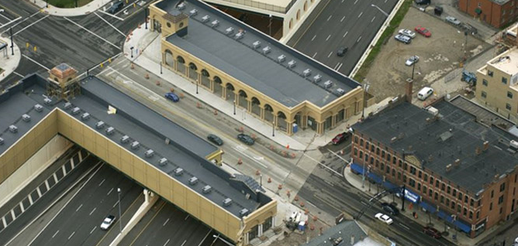
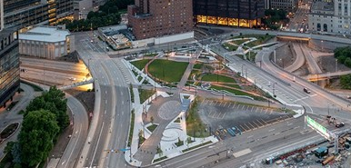
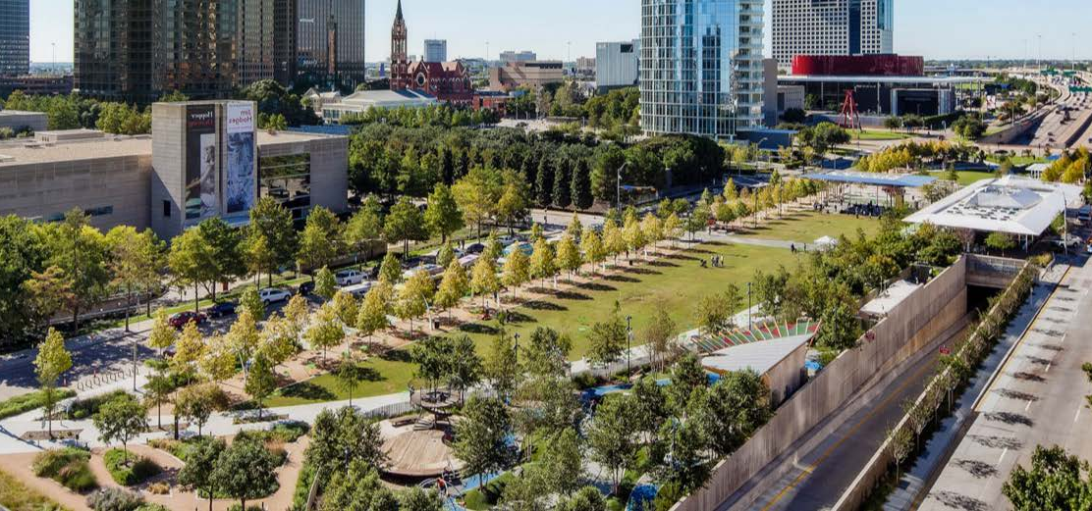
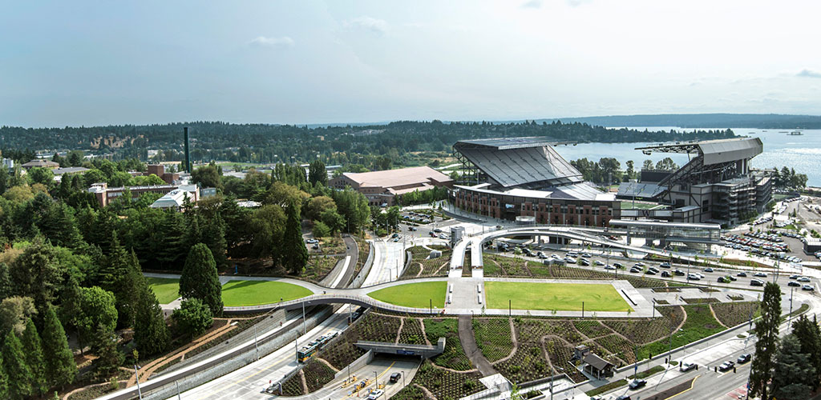
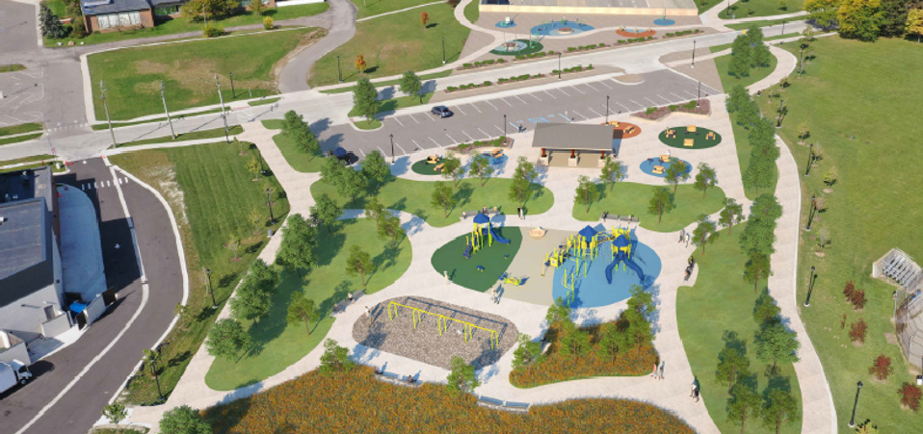
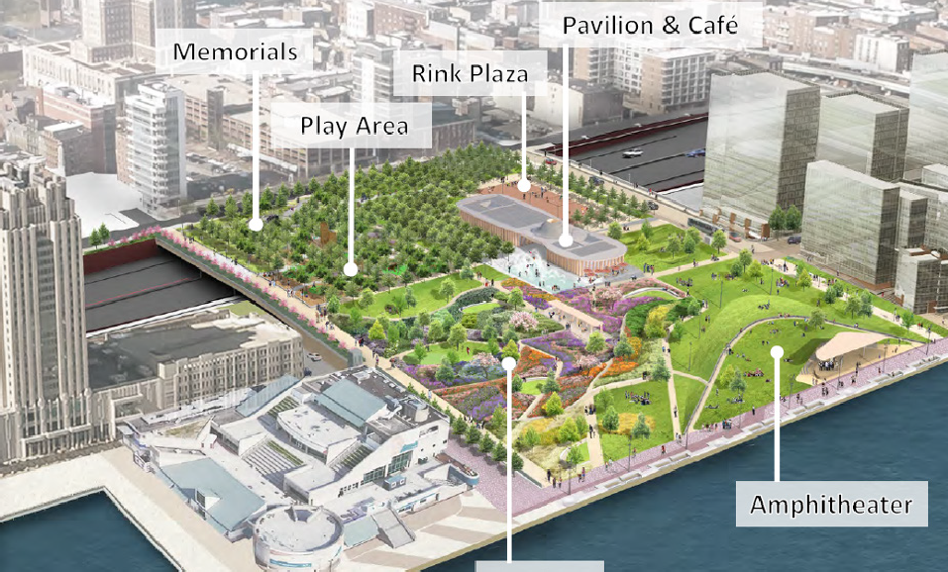
Urban Highway Capping Projects
L
M
S
The Cap at Union Station, Columbus, OH
Frankie Pace Park, Pittsburgh, PA
Klyde Warren Park, Dallas, TX
Lower Rainer Pedestrian Land Bridge, Seattle, WA
Bridging I-696: Connecting Oak Park, Oak Park, MI
Park at Penn’s Landing, Philadelphia, PA
Notes:
Jeromie

Slide 4





Potential Goals and Opportunities for I-75
OUR EXPERTISE
Promote Equity and Opportunity in Downtown and Neighborhoods
Advance Sustainability
and Resiliency
Foster Community-
Centered Public Spaces
Provide Enhanced
Connectivity and Mobility
Notes:
Jeromie

Slide 5
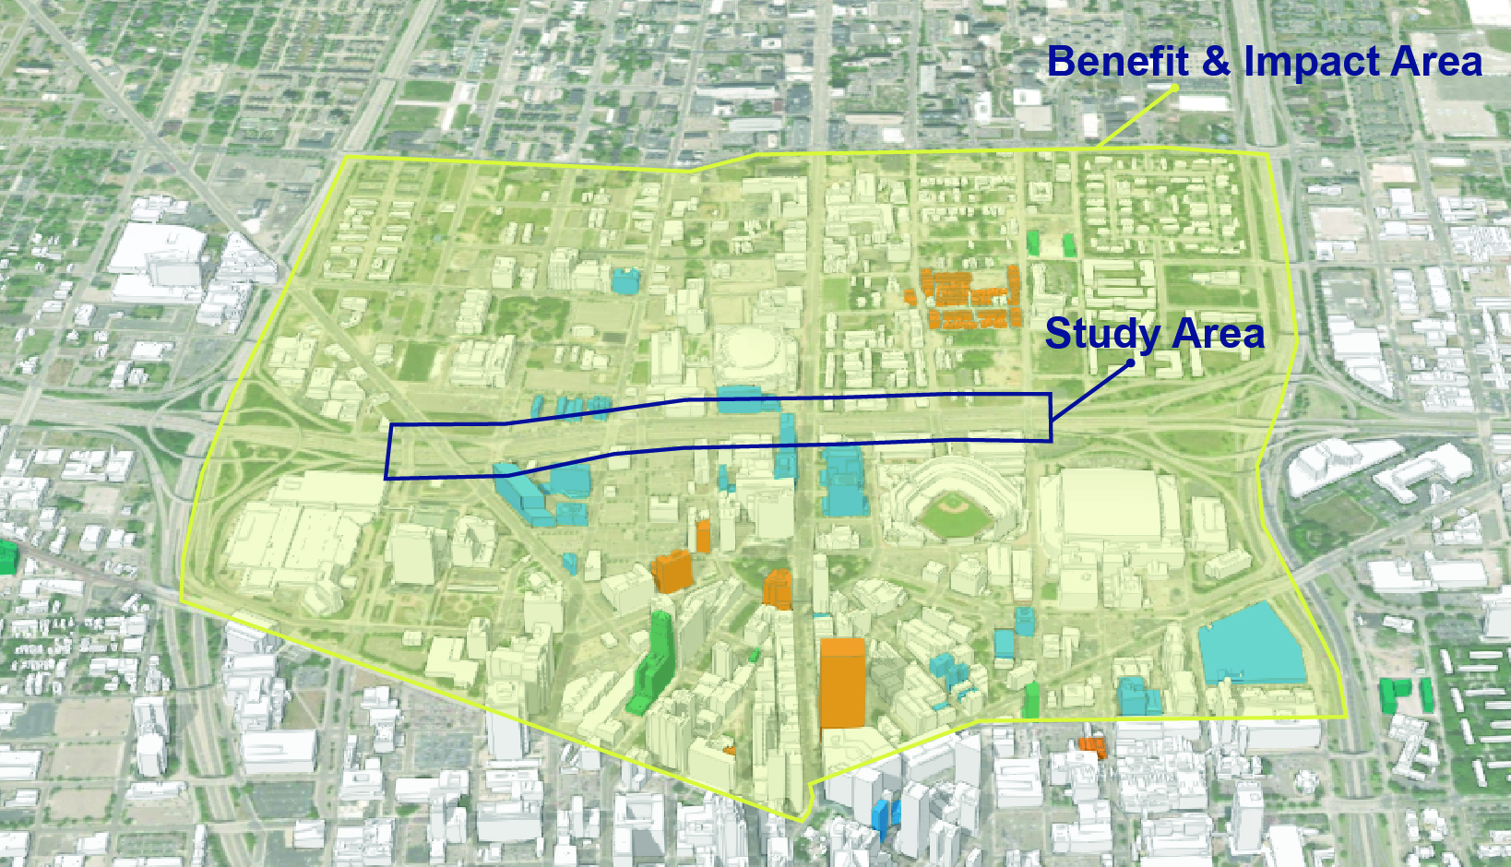
I-75 Cap Study Benefit & Impact Area
OUR EXPERTISE
Notes:
Jeromie

Slide 6
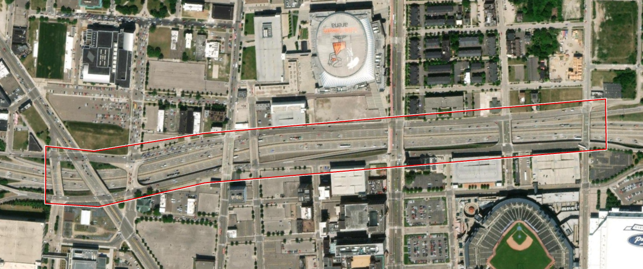
I-75 Cap Study Area
OUR EXPERTISE
3rd
Ave.
Grand River Ave.
Cass
Ave.
Woodward Ave.
Brush
Street
Notes:
Jeromie

Slide 7
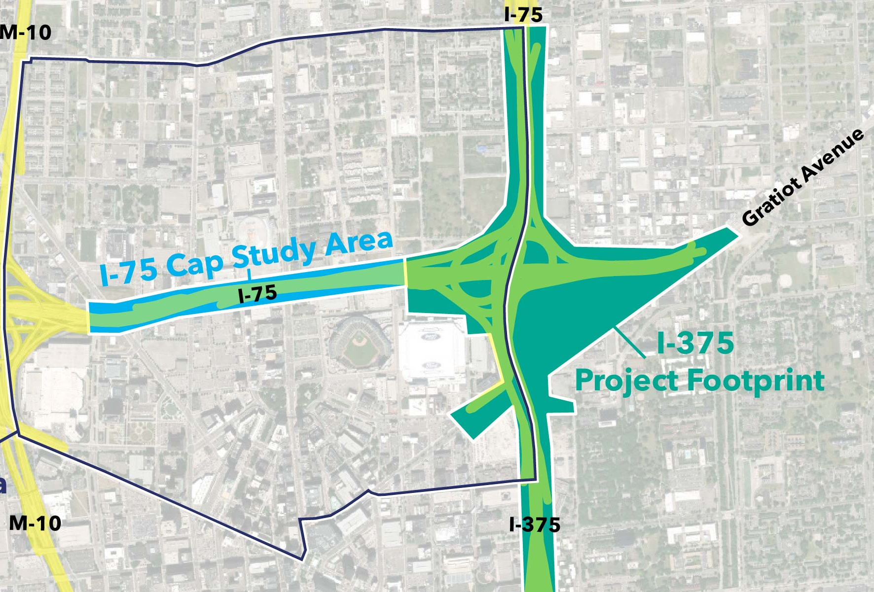
Relationship to I-375 Project
OUR EXPERTISE
Adjoining project areas, and planning for each will need to be coordinated and collaborative
Projects have very important differences:
  I-375 Project is a transportation infrastructure project being advanced by MDOT; conceptual design and environmental studies completed.
  I-75 Cap is a planning project being led by DDP to determine potential capping treatments along I-75; no specific design concepts or timeline for construction.
Additional information on I-375, including opportunities for input, can be found at: https://www.michigan.gov/mdot/projects-studies/special-construction/i-375-reconnecting-communities-project
Notes:
Jeromie

Slide 8

I-75 Cap Study Project Schedule
Phase 1
Community Goals / Needs
June
Phase 2
Capping Options
August
Phase 3
Preferred Option(s)
October
Future
Environmental Studies, Design and Construction
I-75 Cap Study (2024)
Notes:
James / DDP

Slide 9
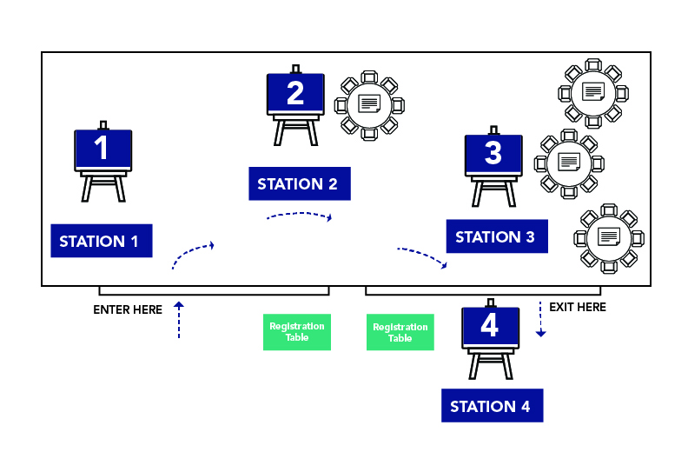
Public Meeting #1 – Overview
OUR EXPERTISE
Station 1
Learn about other urban capping projects and how they relate to I-75
Station 2
What neighborhood spaces and places could benefit from a cap?
Station 3
What specific opportunities should we explore in study area?
Station 4
Before you leave … leave your survey and do you have other questions?
Presentation Times
6:10 – Overview Presentation #1
7:10 – Overview Presentation #2 (same as #1)
7:45 – Discuss Frequent Comments / Questions
Notes:
Terence

Slide 10
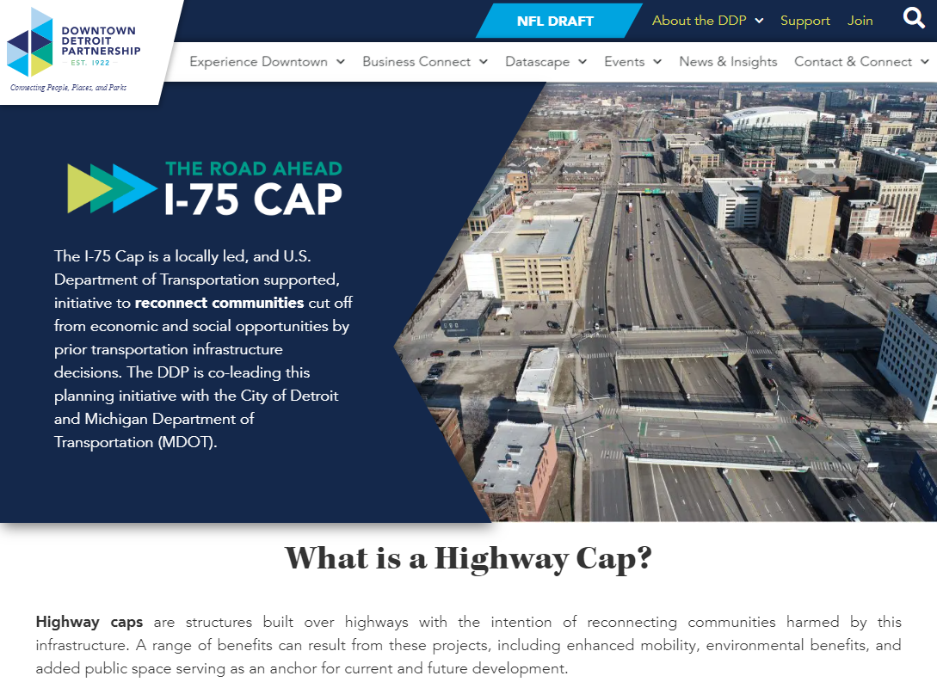
Stay Involved / Tell Your Friends
Project Web Site
https://downtowndetroit.org/i75cap
Phase 1 Digital Survey
Available on Web Site through July 12
(similar feedback requested as from Public Meeting)
Future Public Meetings
Dates to be announced soon!
Questions or Feedback
TheRoadAhead@downtowndetroit.org
Notes:
James / DDP

Slide 11
THANK YOU!

