Slide 1
I-75 Cap Feasibility Study

Slide 2
Project Partners

Slide 3
Project History
DDP receives USDOT FY2023 Neighborhood Access and Equity (NAE) grant to conduct an I-75 Cap Feasibility Study – January 2024
MDOT/City of Detroit awarded a federal earmark to advance project engineering – January 2024
DDP undertakes 8-month community-led Visioning and Alternatives Analysis – April-December 2024
Community and project partners select three cap preferred alternative – September 2024
MDOT awarded a Reconnecting Communities Program (RCP) grant to advance project to construction readiness – January 2025

Slide 4
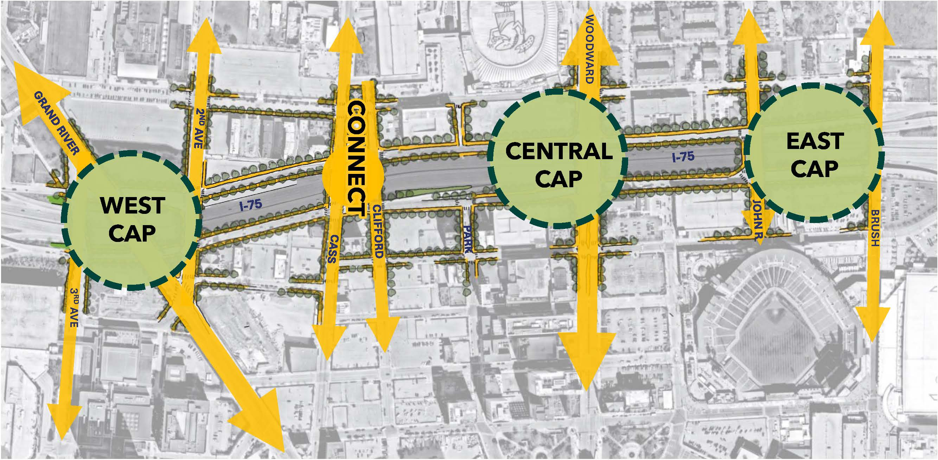
Preferred Alternative

Slide 5
I-75 Cap Feasibility Study Goals
Determine location and size of park caps based on preliminary site survey, ventilation study, structural design concepts, transportation study, and community feedback
Research to support Environmental Class of Action determination
Develop public space design as part of community-led process
Update cost estimates and develop Operations and Maintenance Plan with project partners

Slide 6
Scope of Work: 1. Transportation Design and Engineering
Transportation Study
Potential changes to I-75 access and the local street network for all modes (coordinate with I-375 project)
Interstate Access Change Request needs
Safety and operations analysis and model improvements
Hazardous materials routing
Environmental Review
Research to support NEPA Class of Action

Slide 7
Scope of Work: 1. Transportation Design and Engineering (Continued)
Engineering Design
Preliminary site survey
Ventilation study (avoid need for mechanical ventilation)
Advance structural design concept
Analyze constructability and phasing (in coordination with I-375)
Prepare drainage concepts
Update capital cost estimates

Slide 8
Scope of Work: 2. Park Design and Placemaking Plan
Develop schematic design package for proposed public space and local street right-of-ways within project area
Develop program and placemaking plan for each public space
Integrate public space, program, and placemaking plan with capital and operational cost estimates with the overall project

Slide 9
Scope of Work: 3. Community Engagement
Develop inclusive community engagement plan to ensure that all demographic groups are kept informed and provided opportunity to participate in the development of the Feasibility Study
Conduct monthly stakeholder meetings – virtual or in-person – with project stakeholder group
Convene public meetings as part of a broad and inclusive participatory planning process

Slide 10
Project Schedule
12 Month Project
Start: May 2025
End: April 2026

Slide 11
Submittal Requirements
Project approach: detailed description of your approach to the project with associated schedule to complete
Project personnel: org chart, resumes, and description of the role of each team member, including project executives, towards the completion of the project
Prior experience: at least three examples of completed work of a similar scale, budget, and scope

Slide 12
Desired Project Team Composition
Transportation Engineering
Public Space Design & Placemaking
Community
Engagement

Slide 13
Desired Project Team Composition
Front load engineering work?
Transportation Engineering
Be creative. Design charrettes?
Three caps; three designers?
Overall master planner?
Public Space Design & Placemaking
Community
Engagement

Slide 14
RFP Selection Process
RFP Released: March 24, 2025
Bidder Question & Answer: April 2, 2025
Proposals due: noon on April 23, 2025
PDF format delivered by email to: james.fidler@downtowndetroit.org isaac.douglas@downtowndetroit.org
Interviews: week of April 28, 2025
Selection: May 7, 2025

Slide 15
Questions?

